Slide 1
DSE 6220
Big Data
Hadoop & Spark
Week 8

Slide 2
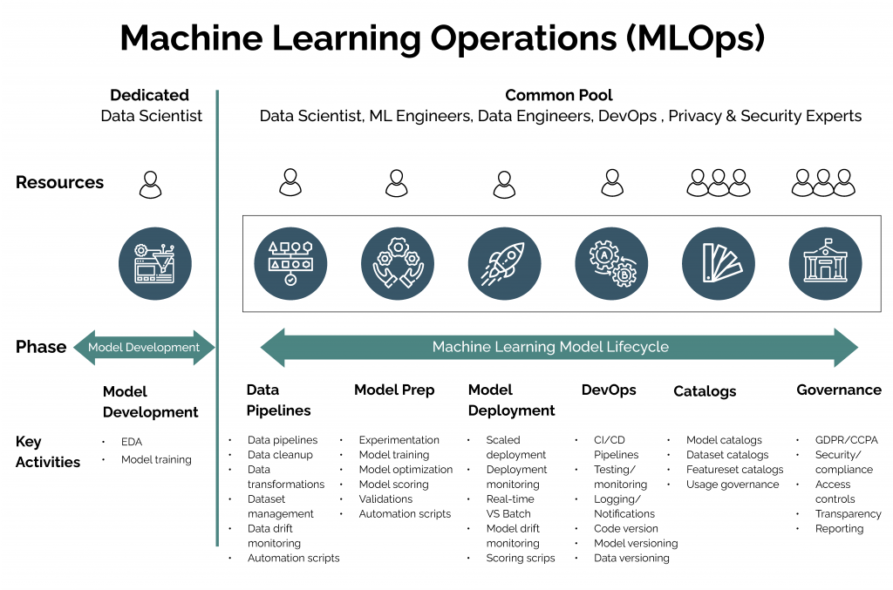

Slide 3
Model Management
Reproducible research
The ability to reproduce your development environment in a production environment
Library versioning
Best practice is to build a requirements.txt file for your environment
Data evolution
Data drift/model drift. Data changes over time
Order of execution
Notebook hell – notebooks are stateful and data scientists are notorious for running code chunks out of order in notebooks
Parallel operations
Parallel computations are not always executed in order which can cause differences in outputs in some scenarios

Slide 4
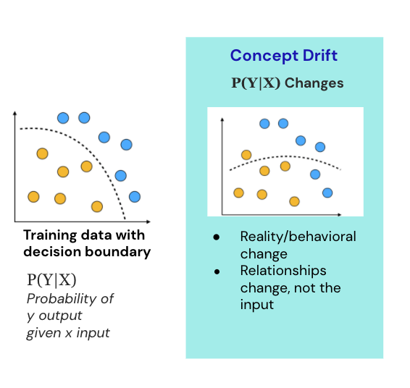
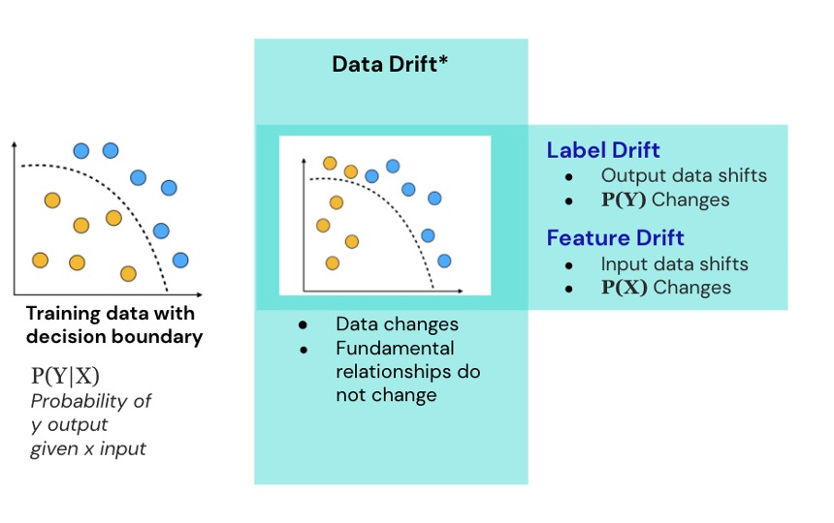
Types of Model Drift

Slide 5
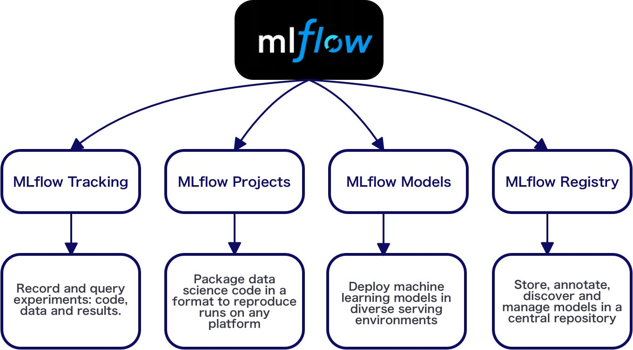
MLFlow https://mlflow.org/

Slide 6
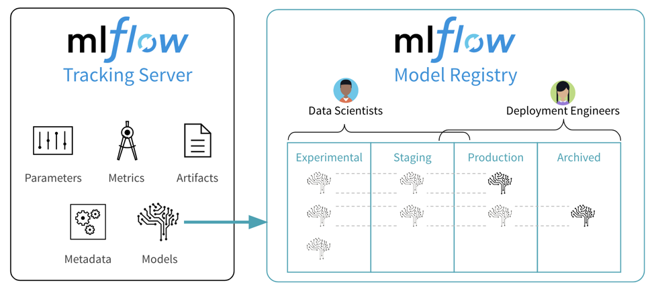
Tracking
Logging API that is agnostic to the libraries and environments that train the models
Tracking server can host many experiments
Parameters
K/Vs aka hyperparameters
Metrics
RMSE, accuracy, F1 score etc
Artifacts
Files, data , models, images etc
Metadata
Information about the run
Models

Slide 7
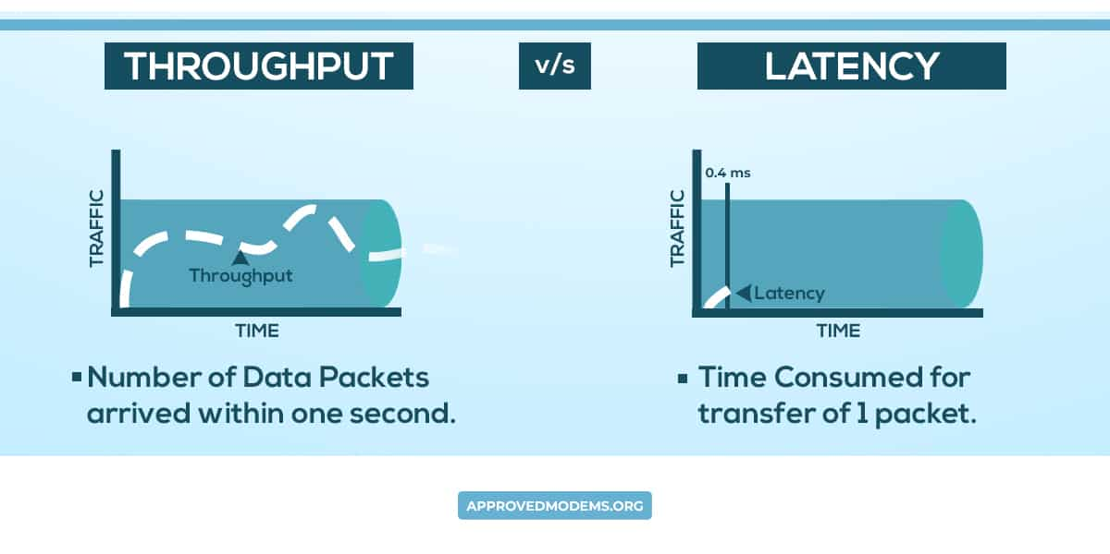
Deployment Options
Business impose requirements on throughput and latency
Batch
High TP
High Latency
Streaming
Medium TP
Medium Latency
Real-time
Low TP
Low Latency

